Slide 1




Migration, fertility, and population replacement in Europe
Tomáš Sobotka
Vienna Institute of Demography (Austrian Academy of Sciences), Wittgenstein Centre for Demography and Global Human Capital
Suessmilch Lecture, Max Planck Institute for Demographic Research, Rostock, 18 February 2016

Slide 2
Background
Four decades of sub-replacement fertility in Europe
EU-wide period TFR fell below 2.1 births per woman in 1975, now at 1.55 (2013) (NL 1.68)
Four decades of debates about the forces underlying the shift to low fertility
Four decades of worries and policy discussions concerning low fertility

Slide 3
Governments & politicians are worried:
Jacques Chirac (1984): “Europe faces a “demographic slump. (…) Twenty years or so from now, our countries will be empty (…)” (Teitelbaum, 2000).
Eur. Commission, The Green Paper (2005): low birth rate is a “challenge for the public authorities”; “return to demographic growth” one out of “three essential priorities”

Slide 4
Governments & politicians are worried:
Jacques Chirac (1984): “Europe faces a “demographic slump. (…) Twenty years or so from now, our countries will be empty (…)” (Teitelbaum, 2000).
Eur. Commission, The Green Paper (2005): low birth rate is a “challenge for the public authorities”; “return to demographic growth” one out of “three essential priorities”
Demographers and economists are worried:
J. C. Chesnais (2001): population implosion in the 21st century may be particularly pronounced in Europe
David S. Reher (2007): Extremely low fertility “has been around for too long”…
Pritchett and Viarengo (2012: 55): Large parts of Europe committing “gradual demographic suicide”

Slide 5
Governments & politicians are worried:
Jacques Chirac (1984): “Europe faces a “demographic slump. (…) Twenty years or so from now, our countries will be empty (…)” (Teitelbaum, 2000).
Eur. Commission, The Green Paper (2005): low birth rate is a “challenge for the public authorities”; “return to demographic growth” one out of “three essential priorities”
Demographers and economists are worried:
J. C. Chesnais (2001): population implosion in the 21st century may be particularly pronounced in Europe
David S. Reher (2007): Extremely low fertility “has been around for too long”…
Pritchett and Viarengo (2012: 55): Large parts of Europe committing “gradual demographic suicide”
…and even the popes are worried:
Benedict XVI (Christmas 2006): Europe “…seems no longer wants to have children” (…) and “seems to be wishing to take its leave of history”
Francis (15 Sep. 2015): “I think about the level of births in Italy, Portugal, and Spain. I think that it’s almost 0%. So, if there are no children, there are empty spaces. (…) the great challenge of Europe is to return to being mother Europe”

Slide 6
Many governments want higher fertility....
Government view on fertility level and government policy on fertility in 22 countries ever reaching a period total fertility rate of 1.40 or below
Source: UN reports, UN World Population Policy Database; http://esa.un.org/PopPolicy/about_database.aspx

Slide 7
Why worry about low fertility?
The worries on low fertility often linked to concerns about population size (decline or potential decline), age structure (accelerated aging, lack of labour force), surplus of deaths over births, spatial distribution or population composition (by national or ethnic groups)
Even when real, higher fertility is often no solution or the least efficient solution
These concerns often ignore long-term changes in population size and distribution through migration

Slide 8
Why migration matters more than you might think
Well before the current spectacular migration movements, migration had become an important and underappreciated force in European demographic landscape

Slide 9
Why migration matters more than you might think
The double effect of numbers of migrants & their younger age
Common believe that migration has only a limited influence
The “third demographic transition”? (Coleman 2007)
Consistently underestimated in population projections for EU countries
European migration split: the shrinking Central & Eastern & south-Eastern Europe (ex. Russia) vs. rising West, South & North
  Migration fuels new demographic divides in Europe
  Population trends more disconnected from fertility
  CEE: Combined emigration AND low fertility
  Pop. change partly conforming to the idea of European population implosion
  West, South & North: rapid population growth in some regions despite persistent low fertility

Slide 10
Agenda
The new migration & population divides in Europe
  The shrinking East and the rising North-West
  Long-term emigration in the East: an underappreciated force
Uncertain demographics: increasing difficulties of counting people and measuring population trends
Migrants’ contribution to births and fertility in Europe
  Fertility convergence accelerated during the recession period
  The rising share of births to migrant women
Measuring population replacement: combining fertility and migration
  The misleading fixation on replacement fertility
  Different ideas, assumptions & indicators
  The “over-replacing” West?
Population upturns and reversals in a low-fertility setting: the case of Vienna

Slide 11

The shrinking East?
The new migration & population divides in Europe
Source: European Parliament,
http://www.europarl.europa.eu

Slide 12
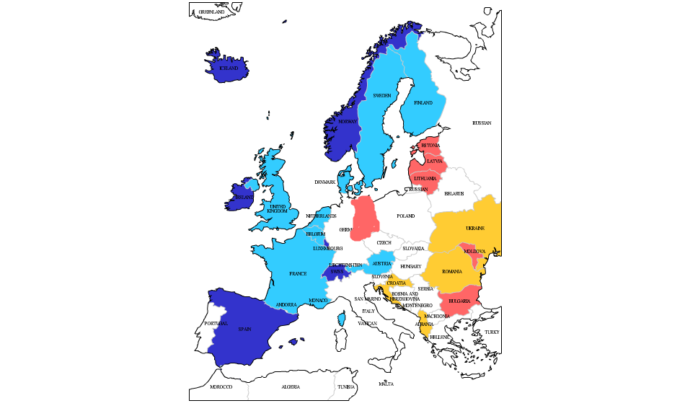
East-West division in relative population change, 1989-2013, in %
Decline 15-25%
Decline 10-14%
Increase 10-19 %
Increase 20+ %
Data source:
Own elaboration of Eurostat 2015
Map creator: http://edit.freemap.jp/en

Slide 13
East: The incredible shrinking region?
Population change since the 1990s: The triple forces of falling or low fertility, emigration, and in some regions high mortality, esp. of men
Huge differences in migration & mortality trends
Cumulative pop. decline 1989-2015: ca 23 million out of 360 million
Emigration driven by the economic slump, uncertainties & low living standards combined with the lifting of the travel restrictions
EU members: access to labour market & social protection in other countries (with a delay) fuelled increased migration
The effects of the recession, 2008-12
Peripheral position far from the “Blue Banana” zone? (Kluesener & Zagheni 2013)
Rough estimate of net migration loss, without Russia: 8-10 million in 1989-2013 out of pop. 212 mill (including eastern Germany); 6-8 million ex. Eastern Germany. Russia: migr. gain of 8.3 mill in 1989-2012

Slide 14
Relative population change, 1989-2012 or 2013: Net migration vs. Natural pop. increase
Data source: Eurostat 2015, national statistical offices, www.pdwb.de

Slide 15
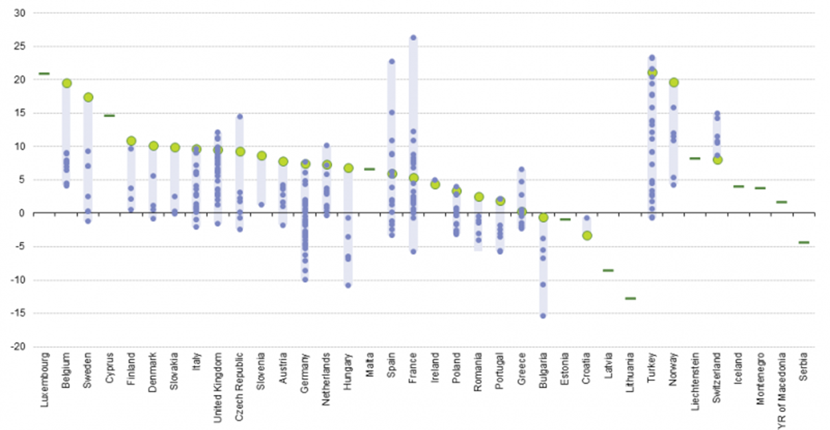
Regional differences in population change: the drive of the capital cities?
Average rate of population change (per thousand), NUTS-2 regions in Europe, 2008-12
Source: Eurostat database, http://ec.europa.eu/eurostat/statistics-explained, picture RYB14.png; accessed 23 March 2015

Slide 16
Sex- and age-specific differentials in migration
In most countries migration strongly concentrated into ages 18-35
Also sex differentials
Highly educated leave more frequently
Strong effects on reproduction/number of births, labour force size and human capital distribution of the population

Slide 17
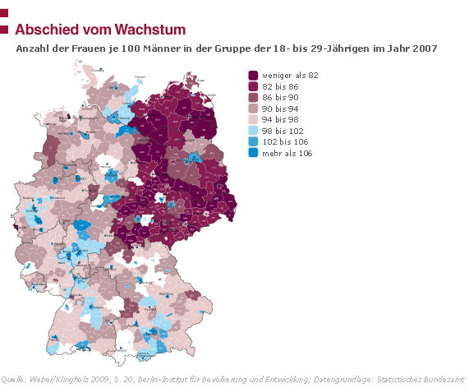
Sex- and age-specific differentials in migration
In most countries migration strongly concentrated into ages 18-35
Also sex differentials
Highly educated leave more frequently
Strong effects on reproduction/number of births, labour force size and human capital distribution of the population
Number of women per 100 men aged 18-27 in German districts, 2007
The “left over” men in eastern Germany
Source: Berlin Institute 2010, http://www.berlin-institut.org/publikationen/studien/not-am-mann.html

Slide 18
Where has everyone gone?
Young Romanians abroad
Romanian “losses” due to migration
Age 30-34: peak reproductive and productive ages, high cumulative migration
In 2014, ca 1.78 mill. Romanians surviving, out of 1.86 mill. born in 1979-83

Slide 19
Where has everyone gone?
Young Romanians abroad
Romanian “losses” due to migration
Age 30-34: peak reproductive and productive ages, high cumulative migration
In 2014, ca 1.78 mill. Romanians surviving, out of 1.86 mill. born in 1979-83
Source: own estimations based on Eurostat database

Slide 20
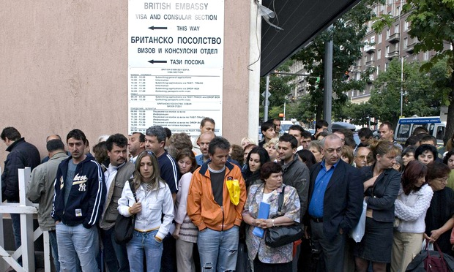
Where has everyone gone?
Young Bulgarians abroad
I. Krastev (2015): The seven samurai on the streets of Sofia
http://www.theguardian.com/commentisfree/2015/mar/24/britain-east-europe-brain-drain-bulgaria

Slide 21
Where has everyone gone?
Young Moldovans abroad
Share economically active population estimated working abroad:
2000: 8.4%; 2013: 27.0% (UNFPA, CCD/INCE 2014, Tab. 9.1)
Split families, abandoned kids:
1.4% of kids left without parental care & placed in institutions in 2005
>20% of school-aged kids had parents living abroad in 2005-10
(UNFPA, CCD/INCE report 2014, Tab. 6.4)

Slide 22

Managing population decline & ageing
Depopulating towns in Eastern Germany
Older streets are gap-toothed where wreckers have removed abandoned houses. Cityscapes are being pruned, removing dead and dying edifices in the hope of saving the rest.
Tearing itself down
Economist, April 10, 2008
Aschersleben, Saxony-Anhalt
Source: The Economist, http://www.economist.com/node/11025721

Slide 23
Uncertain demographics:
Increasing difficulties of counting people and measuring population trends

Slide 24
Uncertain data?
Emigration countries:
Difficulties registering outmigration
Ghost populations: Outmigration underestimated, inflated population size
Post-Census adjustments + retrospective inter-censal estimates (now required by Eurostat)
“Temporary” migration and different census rules make these estimates difficult to compare
The examples of PL, Moldova
Immigration countries:
Difficulties of dealing with irregular / non-authorised immigration (plus legalisation waves)
Unregistered return migration
New techniques, surveys and methods

Slide 25
Consequences for measuring fertility
Population estimates & vital statistics data strongly affected by migration for younger adults + peak productive ages (18-35), but also early post-retirement age
This can bias indicators of fertility (marriages, mortality…)
Two main types of bias:
Numerator bias: Events that took place abroad and should be registered in other countries are retrospectively entered into country’s vital statistics → inflates fertility rates (e.g., Slovakia before 2013)
Denominator bias: Population numbers inflated when emigration under-registered →downward-biased estimates of fertility
These biases can affect fertility by up to 20% in some age groups
Even the census might not set the record straight: PL 2011: official population 38.501 mill; “usually resident pop.”: 37.244 mil. (Golata)

Slide 26
How much can fertility data change after revisions?
Period TFR estimated before and after the 2011 Census-based adjustments for 2001-11, as published by Eurostat in Nov. 2013
BULGARIA
ROMANIA
LATVIA

Slide 27
The effect on age-specific fertiltiy prior and after the revision
ASFRs in 2011 estimated before and after the 2011 Census-based adjustments, as published by Eurostat in Nov. 2013

Slide 28
Revised collection of live birth data in Slovakia, 2012
Data on live births to Slovak citizens that took place abroad included until 2011, excluded from 2012
Total Fertility
Mean age at first birth
Data received courtesy of Brano Sprocha, INFOSTAT

Slide 29
Germany: Post-2011 revision of period TFRs
Period TFR: biased estimates of trends & levels for foreign-born women in Germany, 2001-11
Source: Statistisches Bundesamt (destatis), 2015

Slide 30
Mystery upturns: solving a TFR puzzle Lithuania
TFR (2010) = 1.50
(includes mothers and births de facto abroad, but registered as in Lithuania)
TFR reported in 2012-13 for 2011: 1.80!!!
(EXCLUDES mothers abroad (due to post-census correction), but INCLUDES births abroad for mothers residing abroad)
After the correction (exclusion of births to mothers abroad) TFR (2011)=1.55
Identification of status of mothers’ residential status using registers: Central Population Register, Social Security Register,
Health Insurance Register, Tax Register
Based on slide and information provided by Domantas Jasilionis, MPIDR

Slide 31
Where is the lowest period fertility in Europe?
Some of the bottom-five ranking countries in period TFR in Europe:
TFR estimated for Bosnia & Herzegovina (2011): 1.21 (BiH Demography YBK 2013); Poland (2013): 1.29 (EUROSTAT); Moldova (2012): 1.26 (EUROSTAT)
Probably an artefact of inflated population estimates, not adjusted for outmigration
Esp. in BiH & Mol the actual population size difficult to establish

Slide 32
The contribution of migrants to births and fertility in Europe

Slide 33
Stylised facts...and reality
Considerably higher fertility than “native” women?
Above-replacement fertility?
Migrants (partly) driving the TFR increase in the early 2000s?
High fertility of women from Muslim countries?
Mixed evidence

Slide 34
Stylised facts...and reality
Considerably higher fertility than “native” women?
Above-replacement fertility?
Migrants (partly) driving the TFR increase in the early 2000s?
High fertility of women from Muslim countries?
Mixed evidence
Data issues; data quality, population estimates, migrants vs. foreign citizens (also DE data)
Group heterogeneity: vast differences between migrant groups
TFR by country of origin: specific “tempo effect” linked to elevated fertility after arrival (e.g., Andersson 2004)
Need to distinguish migrants’ net contribution to the TFR and their contribution to the number of births

Slide 35
Updates of recent trends in migrants‘ fertility in Europe
Data based on Eurostat and national statistical offices
Period through 2013
(Mostly) pertaining to women born abroad vs. those born in the country
Looking at both fertility rates & shares of births to foreign-born women
Computed for European Fertility Datasheet 2015

Slide 36
www.fertilitydatasheet.org

Slide 37
Key findings
Continuing convergence between fertility of “native” and migrant women in most countries (but: data issues in DE and elsewhere)
Accelerated decline in migrants’ fertility during the recession period after 2008

Slide 38
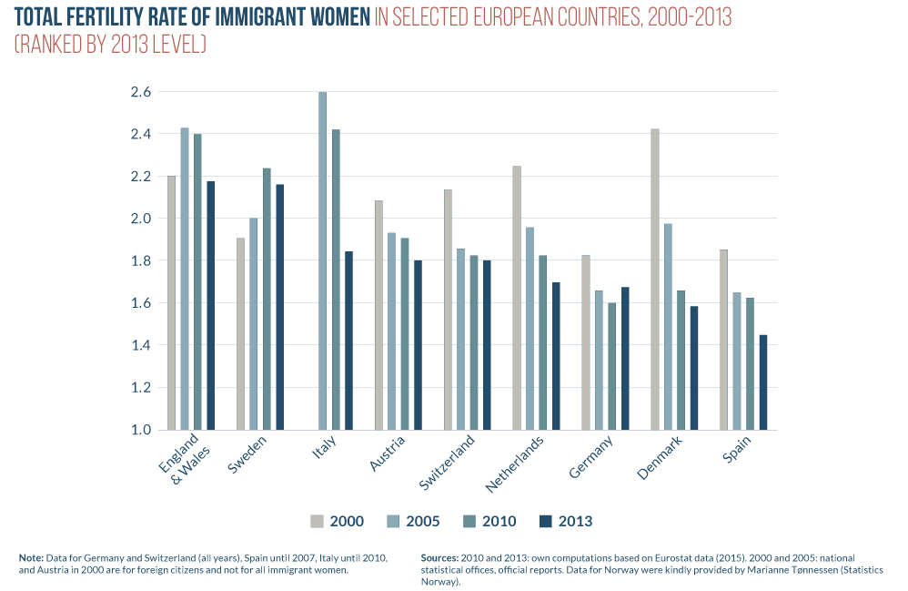

Slide 39
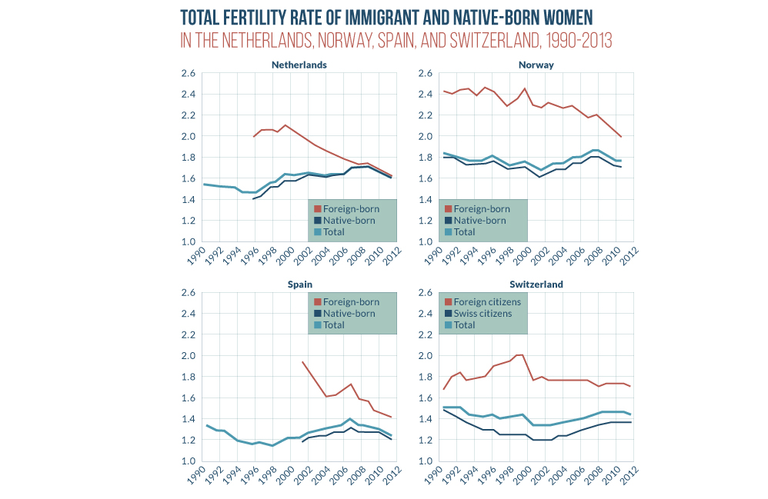
Source: European Fertility Data Sheet 2015

Slide 40
Key findings
Continuing convergence between fertility of “native” and migrant women in most countries (but: data issues in DE and elsewhere)
Accelerated decline in migrants’ fertility during the recession period after 2008
Migrants gave only a slight “boost” to the period TFR in most countries, up to 0.10

Slide 41
Key findings
Continuing convergence between fertility of “native” and migrant women in most countries (but: data issues in DE and elsewhere)
Accelerated decline in migrants’ fertility during the recession period after 2008
Migrants gave only a slight “boost” to the period TFR in most countries, up to 0.10
Migrants have a sizeable (and rising) contribution to the total number of live births in most of Western, Southern and Northern Europe
Continuing East-West divides: very small share of migrant women on population and births in most of Central & Eastern Europe

Slide 42
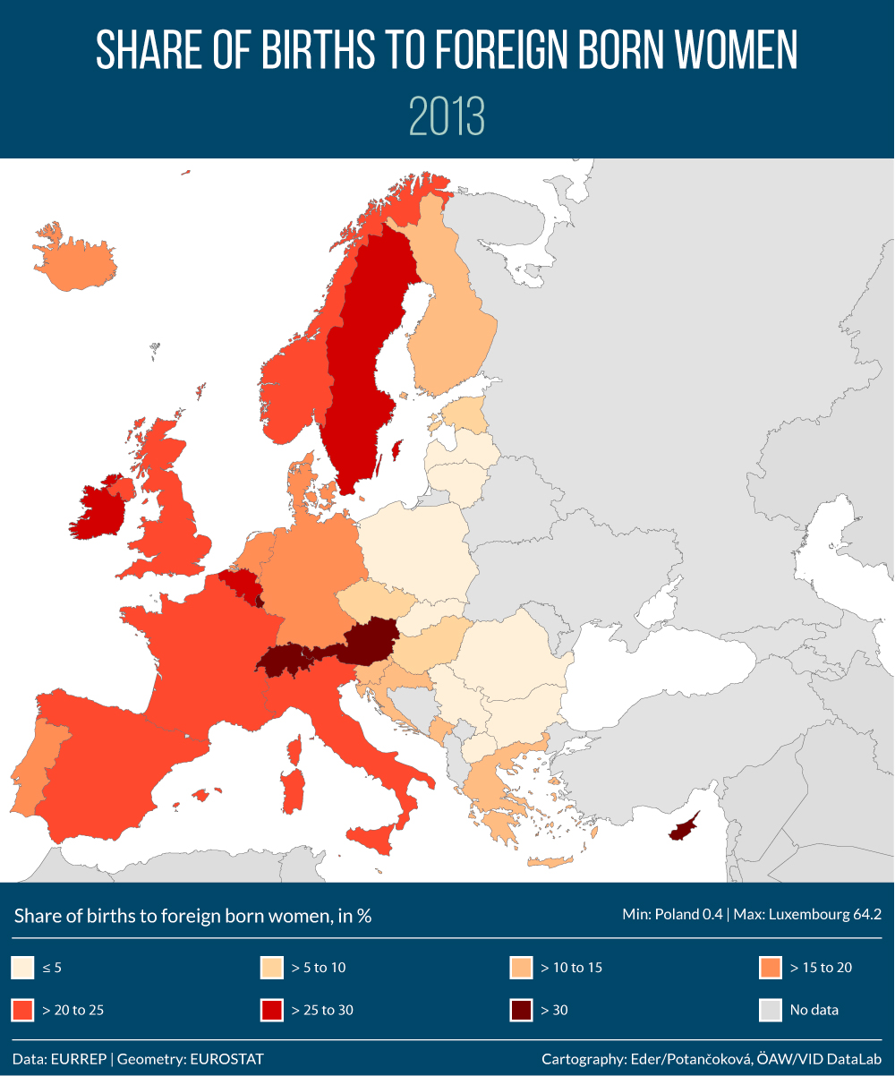
Source: European Fertility Data Sheet 2015, online maps available from 2 December 2015 at www.fertilitydatasheet.org

Slide 43
Measuring population replacement: Combinig fertility & migration
Parts based on Wilson, Sobotka, Williamson and Boyle. 2013. “Migration and Intergenerational Replacement in Europe” Population and Development Review 39(1): 131-157

Slide 44
Why interest in population replacement?
The ideals of reaching a stationary population with fixed size and/or age distribution or achieving long-term equilibrium between fertility and mortality strongly ingrained in demographic thinking
Renewed interest in the role of migration and its possible role in counterbalancing low fertility in rich countries
  Replacement migration (UN 2001, Lesthaeghe 2000)
  Homeostasis (Billari and Dalla Zuanna 2012)
  New look at intergenerational replacement: Methods and indicators that account for the role of migration
  Calot and Sardon 2001, Ortega and del Rey Poveda 2007, del Rey Poveda and Cebrán-Villar 2010; Preston and Wang 2007, Dalla Zuanna 2008, Sobotka 2008, Alho 2008, Ediev et al. 2007, 2012, Ortega 2013, Billari and Dalla Zuanna 2012

Slide 45
ESTABLISHED vs. NEW METHODS
Emerging consensus: migration matters and the traditional measurement of reproduction need to be rethought
parallel debate on tempo effects in period indicators
BUT: Still too much attention on the ‘traditional’ concept of net reproduction rate; continuing obsession with the replacement-level fertility of ca. 2.07 births per woman
Problems with the new indicators
  Little clarity about replacement migration: what component should be ‘replaced’ or kept constant? (population size, age composition, labour force…)
  Confusing array of new indicators: different underlying concepts and assumptions, mixture of period and cohort approaches
  Notoriously unstable migration trends and unreliable migration statistics

Slide 46
The net reproduction rate
Accounting for reproduction (including sex ratio at birth) and mortality from birth through reproductive ages
[f(x,t) · L(x,t)] ·(B^{F}(t)/B(t))
where
t is calendar year
x denotes age
f fertility rate
B^{F}(t)/B(t) observed ratio of female births to total births
L(x) is survivorship from birth to age x

Slide 47
Intergenerational replacement in the presence of migration
Two major concepts:
Birth replacement:
…actual or hypothetical reproduction in the presence of migration
… compares the size of the new “cohort of daughters” at the time they are born to that of their mothers at the time they were born
In population with high immigration, migrants ‘boost’ the observed numbers of births and can make up for the birth ‘deficit’ caused by low fertility
Population replacement:
… not focused on biological reproduction, but on cohort replacement
… migration acts as a mode of population replacement: children are partly born elsewhere and migrate to the country subsequently
… the size of the new “cohort of daughters” (or “child cohort”) related to the “cohort of mothers” (or “parental cohort) not at the time they are born, but at a later point (e.g., at age 30)
…complete population replacement can be reached without reproduction

Slide 48
The net reproduction rate
Accounting for reproduction (including sex ratio at birth) and mortality from birth through reproductive ages
[f(x,t) · L(x,t)] ·(B^{F}(t)/B(t))
where
t is calendar year
x denotes age
f fertility rate
B^{F}(t)/B(t) observed ratio of female births to total births
L(x) is survivorship from birth to age x

Slide 49
Intergenerational replacement: concepts, indicators
Period indicators: unstable, sensitive to data quality and annual fluctuations in migration
Combining period & cohort perspectives using observed data:
  Following real, not synthetic cohorts
  The example of population replacement

Slide 50
Illustration: Cumulative cohort population change over time
Austria: cohort 1974
Live-born females: 47419;
Net Reproduction Rate: 0.96
Hypothetical change in cohort
size in a closed population (no migration)

Slide 51
What was the actual change in cohort size up to age 40?
Expected change
in a closed
pop: -3.2%
(45,900)
ACTUAL
CHANGE????
+11% → 52,600
+22% → 58,000
+33% → 63,000
Hypothetical change in cohort
size in a closed population (no migration)

Slide 52
What was the actual change in cohort size up to age 40?
Expected change
in a closed
pop: -3.2%
(45,900)
ACTUAL
CHANGE:
+11% → 52,600
+22% → 58,000
+33% → 63,000
Hypothetical and actual change in cohort
size, females in Austria, BC 1975

Slide 53
Intergenerational replacement: concepts, indicators
  Population replacement: Overall Replacement Ratio at age a, ORR(a,c) (Wilson, Sobotka, Williamson & Boyle 2013)
  Relating the size of female cohort born in year c when reaching age a to the size of the cohort of mothers in year c
  Can be used to follow changes in cohort size across ages
  Similar indicators by Dalla Zuanna 2008 and Sobotka 2008
  F(a,c,t) is the size of the “cohort of daughters” at age a in year t=c+a;
  F(x,c-x,t=c) is the size of the “cohort of mothers” in year c
  m₁ and m₂ denote the lower and upper boundary of prime reproductive ages for computing the size of the cohort of mothers
  n = m2-m1+1 (number of reproductive ages considered)
    We use ages 20 (m₁) to 39 (m₂) for computing the size of the “cohort of mothers”; focus on age a=30 for the ORR of the “cohort of daughters”

Slide 54
ORR(c,a) at age a = 30
ORR(c, a=30)
    measures cohort intergenerational replacement of women born in year c; affected by migration history of this “cohort of daughters” during the following decades

Slide 55
DATA
Human Fertility Database (HFD, www.humanfertility.org):
Age-specific fertility rates f(x,t)
Ratio of female to total births, (B^{F}(t)/B(t))
Human Mortality Database (HMD, www.humanmortality.org)
Population size by age and sex
Survivorship function L(x) in mortality tables
(derived estimates of annual net migration by age)
Complementary data:
Eurostat database, national statistical offices
22 countries of Europe; complementary data on US, Canada, New Zealand, Japan
Separate data on East and West Germany and UK regions

Slide 56
Main results: Overview of the recent data
Indicators of birth and population replacement, 26 countries

Slide 57
Main results: Overview of the recent data
Number of countries with below-replacement levels of NRR, NBRR and ORR (out of 26 countries, most recent data)

Slide 58
Replacement-level TFR implied by different indicators of birth and population replacement
Recent levels of replacement-level TFR, based on the NRR, NBRR and ORR(30) indicators (selected countries)

Slide 59
Replacement-level TFR: rapid changes over time

Slide 60
EUROPEAN DIVIDES IN POPULATION REPLACEMENT:
A combined view of cohort fertility and migration (ages 15-30) among women born in 1975

Slide 61
Summary & Discussion

Slide 62
Key messages
MIGRATION & POPULATION TRENDS
Population trends increasingly disconnected from fertility levels
Long-term cumulative effects of migration often as powerful for population & age structure changes as the effects of low fertility
East-West contrasts in migration & population trends
The CEE Population Implosion? Emigration accelerating population decline & losses of young population in the East

Slide 63
Key messages (2)
FERTILITY & MIGRANTS’ CONTRIBUTION
Migrant women show a convergence with the “native women” in their period fertility level, accelerated during the economic recession
But a strong & rising contribution of migrants to total live births in many countries
DATA & MEASUREMENT
The continuing attention paid to fertility and “population replacement” based on fertility levels is misplaced
Data issues: difficulty of estimating population size & distribution → problems with measuring fertility and other phenomena

Slide 64
Research & policy agenda: What can (should) we do differently
Need for studying & disseminating indicators measuring joint effects of fertility and migration on population replacement
Need to continue on improving data on migration and on estimating population, especially in CEE (example of Lithuania)
More research on migration as a driver of long-term population changes in cohort size, age structure, population trends, live births, also on a smaller scale
Need to change the obsession of policymakers with fertility levels (esp. the 2.1 boundary)
Need to improve projections and widen the scope of migration scenarios: consistent underestimation of migration in most of Europe in the last four decades
  The argument: High levels of migration here to stay
  Migration as an untapped opportunity for Europe?

Slide 65
Research & policy agenda: What can (should) we do differently
Zygmund Bauman (Europe of strangers, 2010)
The future of Europe and every part of it depends on our ability and willingness to learn to live with cultural diversity.

Slide 66
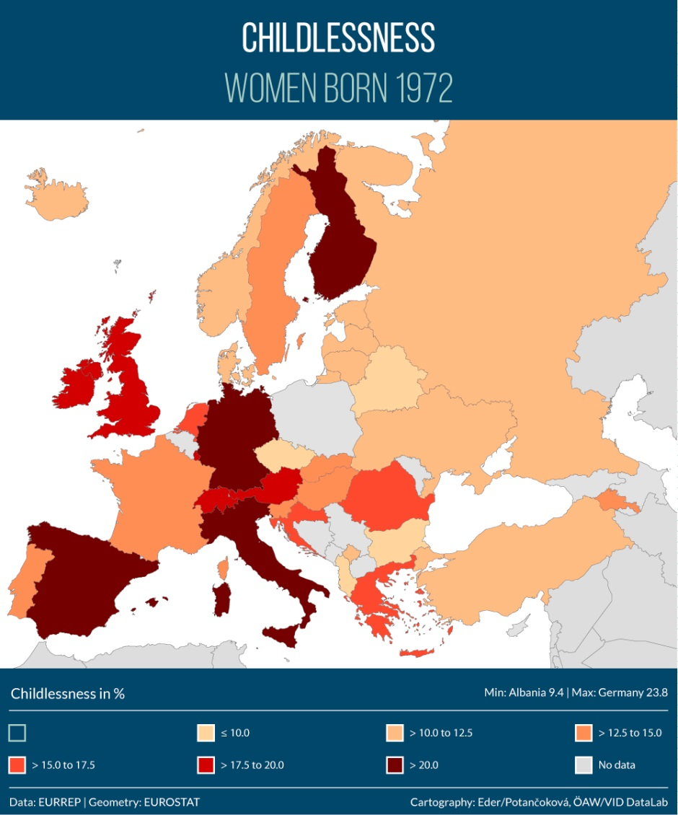
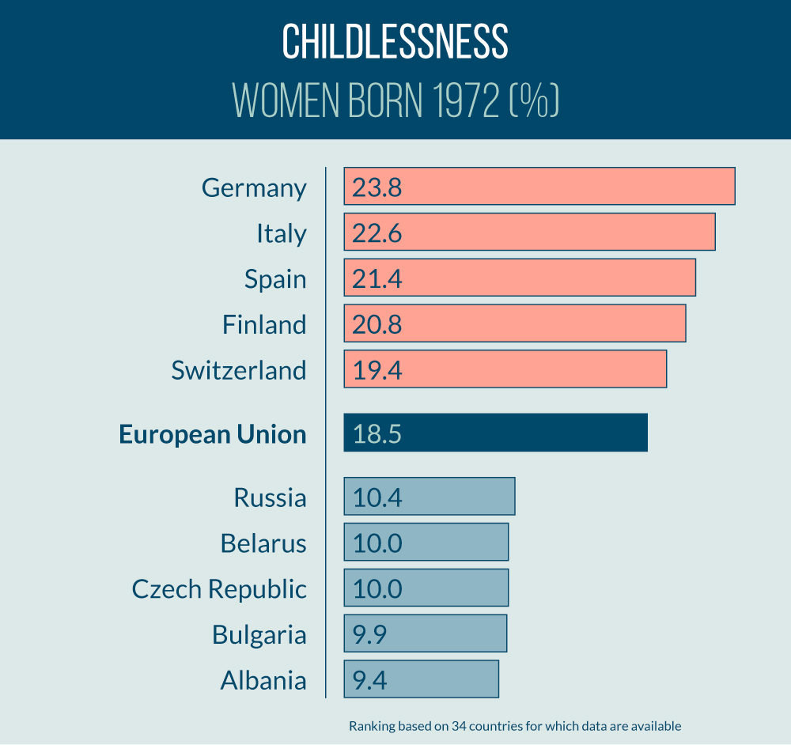
European Fertility Datasheet 2015
Online version: Data, featured highlights & analyses, ranking charts, maps, and expanded documentation

Slide 67


The Human Fertility Database
www.humanfertility.org
Human Fertility Collection
www.fertilitydata.org
www.cfe-database.org

Slide 68

tomas.sobotka@oeaw.ac.at
Work on this presentation was funded by the European Research Council under the European Union’s Seventh Framework Programme (FP7/2007-2013) / ERC Grant agreement n° 284238 (EURREP).
EURREP website: www.eurrep.org

